Slide 1
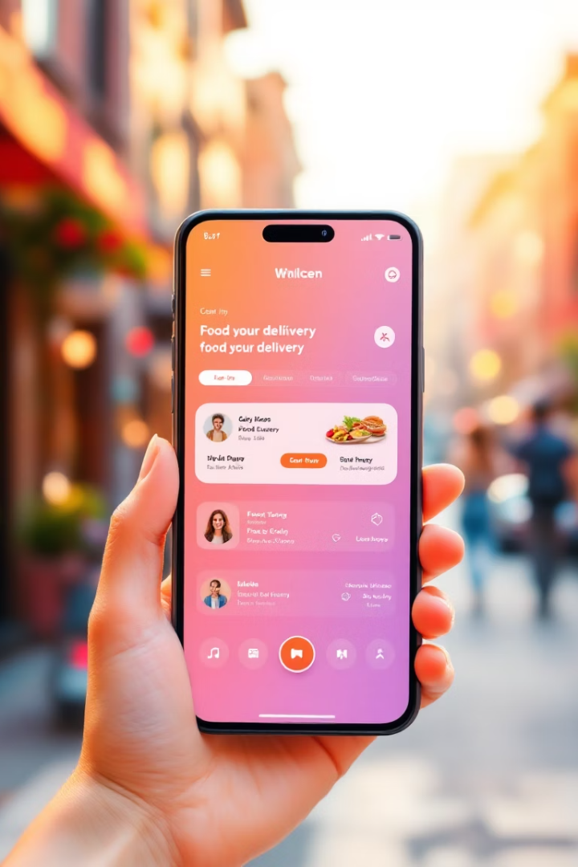
Trintendo – Smart Food Delivery Platform
Created By
Muhammad Bilal
Rana Bilal
Mehboob Ali

Slide 2

The Food Delivery Problem
Inconsistent Experience
High Costs
Many platforms charge high delivery fees and offer few choices.
Users face delays, poor tracking, and limited payment options.
Limited Communication
Poor restaurant and rider communication frustrates customers.

Slide 3
Our Seamless Solution
Track Orders
Wide Restaurant Selection
Secure Payments
Affordable Pricing
Browse many restaurants and cuisines for more choices.
Multiple payment methods and encrypted transactions.
Competitive delivery fees and special offers.
Track orders live with instant updates.

Slide 4
Functional Requirements
Restaurant Management
Order Processing
A restaurant owner shall be able to add, edit, and remove menu items.
A customer shall be able to search for restaurants and food items.
The system shall allow restaurants to mark menu items as available or out of stock.
The system shall allow customers to add multiple items to their cart and modify them before checkout.
Payment Handling
Order Tracking
The system shall support payment via credit/debit cards and cash on delivery.
A customer shall be able to track their order status in real time.
The system shall securely store payment details using encryption.
The system shall display an estimated preparation and delivery time for the order.

Slide 5


Non-Functional Requirements
Security
Performance
The system shall encrypt personal data to maintain privacy and security.
The system shall process orders within 2 seconds to ensure timely order handling.
2
1

Slide 6
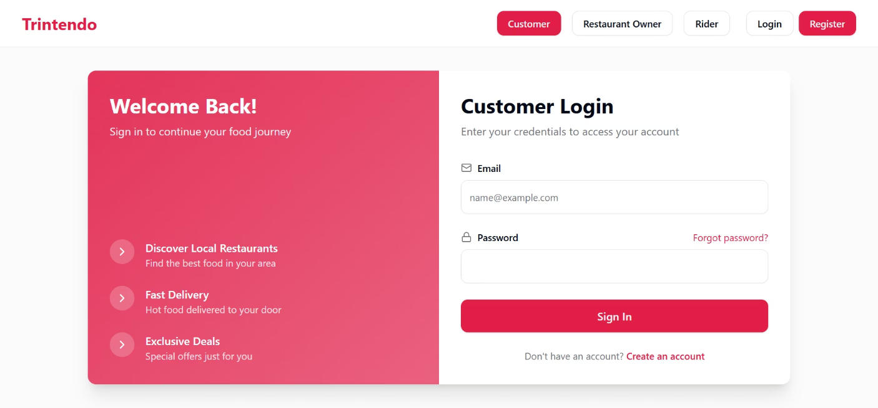

Slide 7
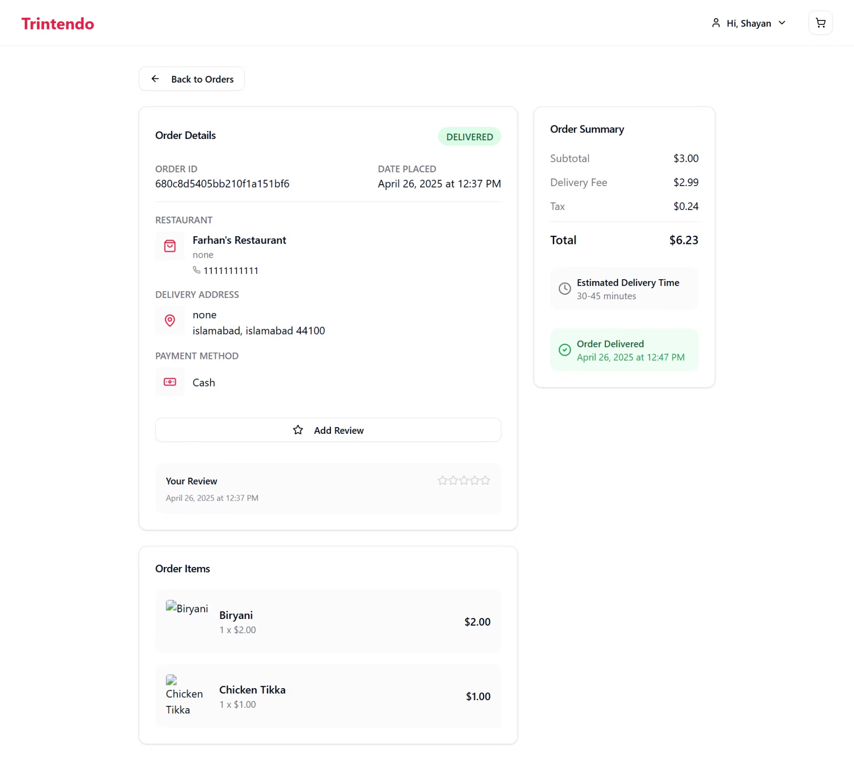

Slide 8
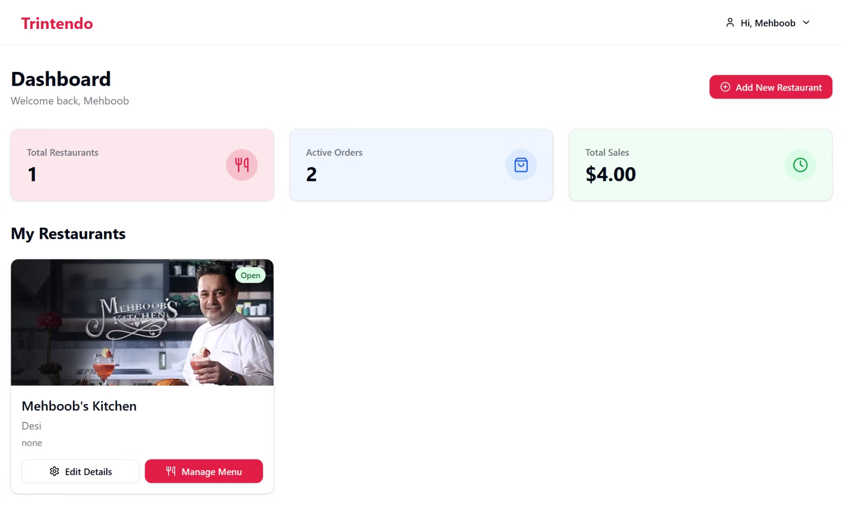

Slide 9
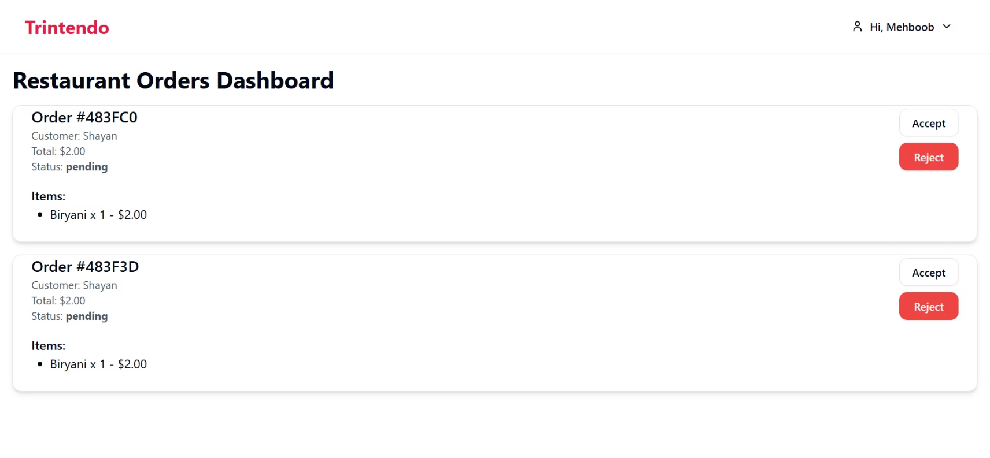

Slide 10
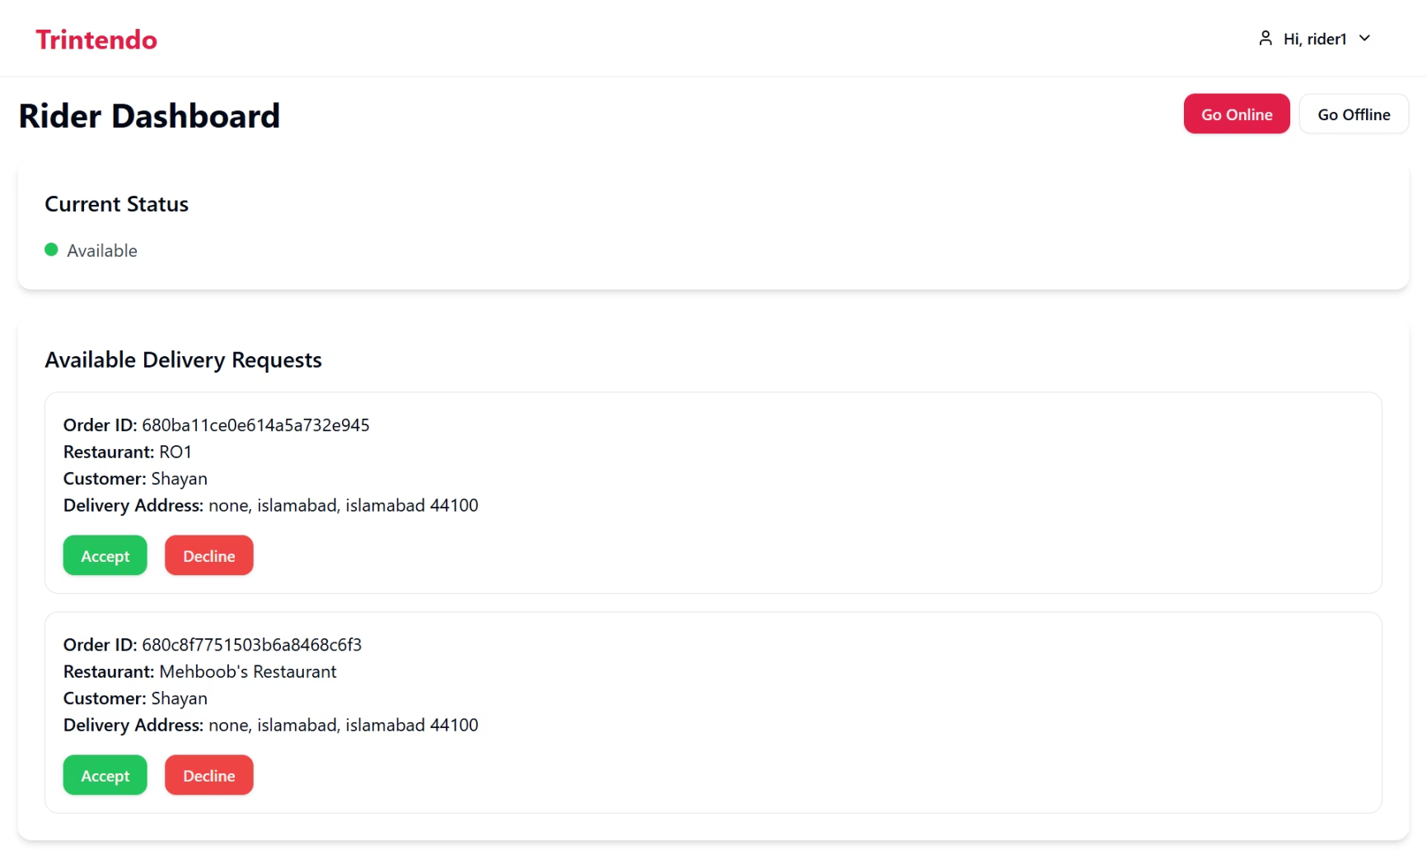

Slide 11
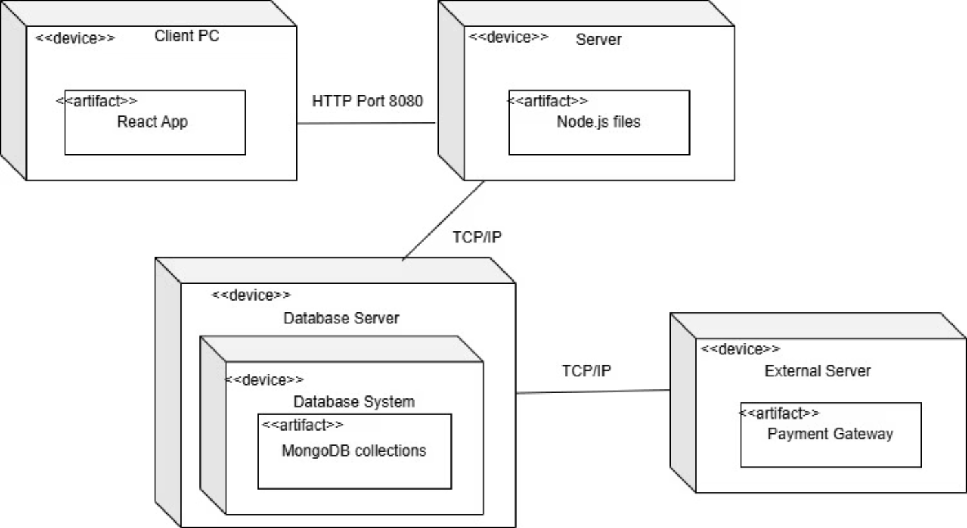

Slide 12
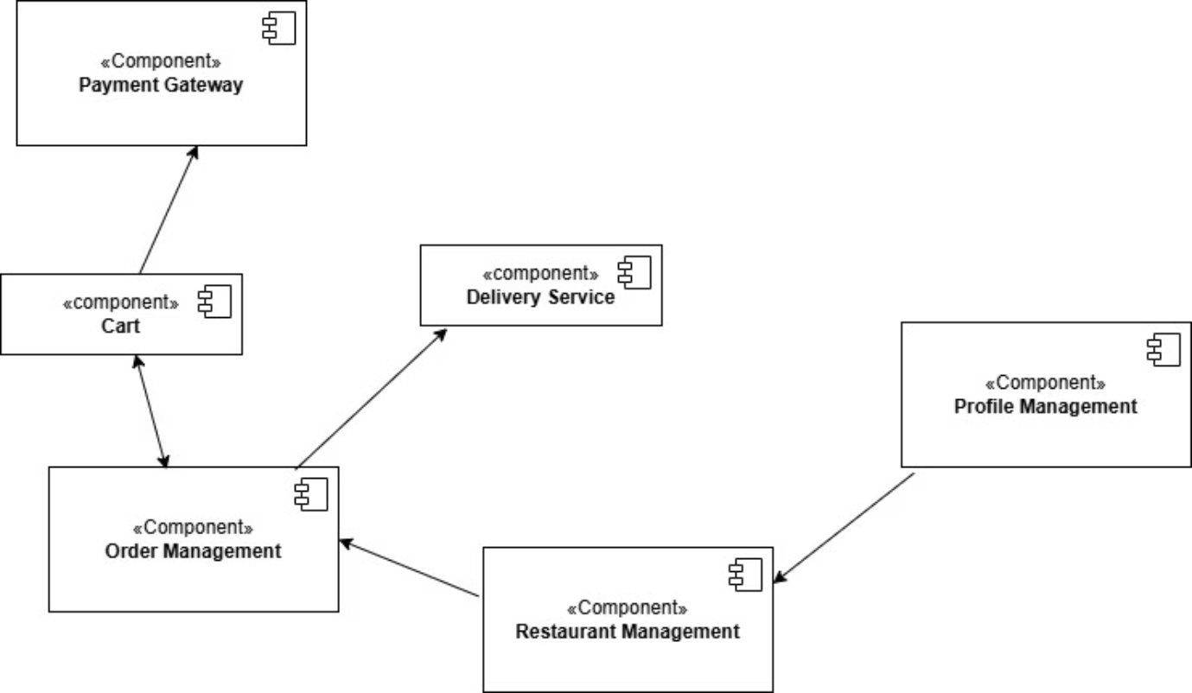

Slide 13
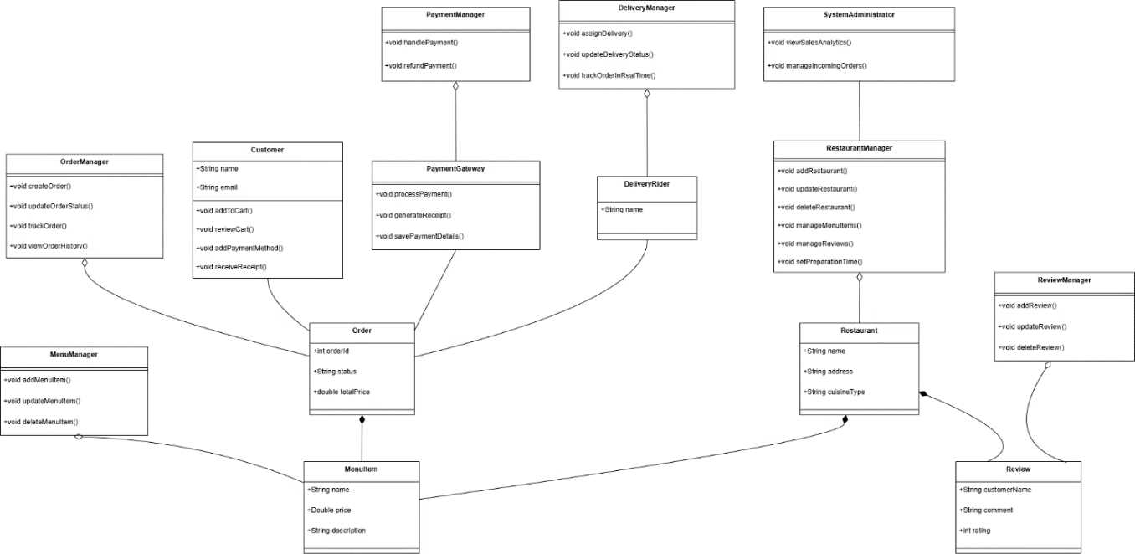

Slide 14
Team Roles & Sprints
Member
Sprint 1
Sprint 2
Sprint 3
Total Focus
Bilal
2 Stories
2 Stories
1 Story
Core Features & Analytics
Rana Bilal
2 Stories
2 Stories
2 Stories
Customer Side + Payment/Tracking
Mehboob
1 Story
2 Stories
2 Stories
Backend Management + Delivery Flow

Slide 15
Lessons Learned
Agile Mindset
Testing Importance
Adaptability and teamwork drive project success.
Early testing saves time and ensures quality.
Effective Communication
Continuous Improvement
Frequent updates prevent misunderstandings and delays.
Apply software engineering concepts in real projects.

